Slide 1
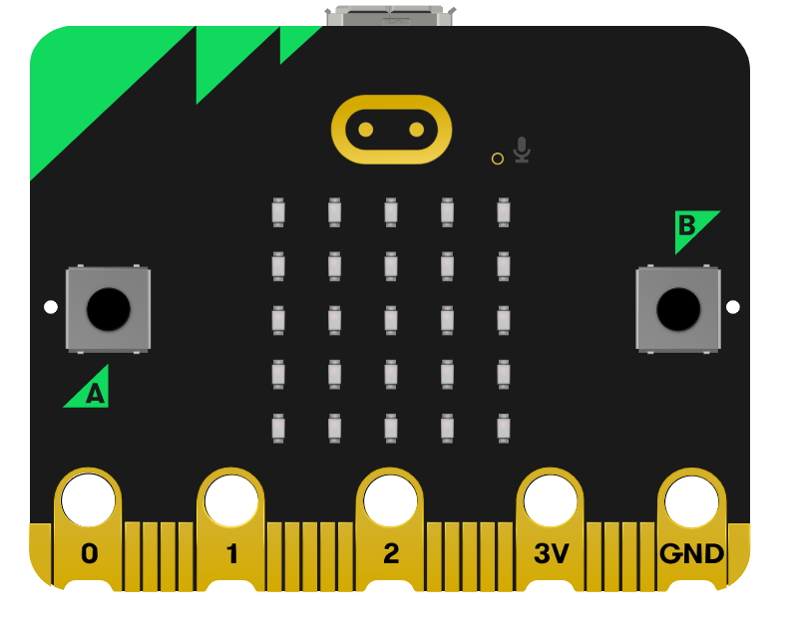
Fitness Frenzy.
Pedometer Information Cards
Digital Schoolhouse, 18a Blackbull Yard, 24-28 Hatton Wall, London EC1N 8JH.
Copyright © 2023 Digital Schoolhouse. All rights reserved.

Slide 2
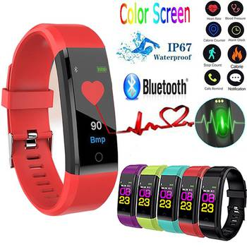
What are the best pedometers?
Some Top Picks
Best Overall: Fitbit Charge 3
Best No-Frills: Realalt 3DTriSport
Best Splurge: Apple Watch
Best Budget: Omron Tri-Axis Best
Big Display: 3DFitBud Simple
Step Counter
Best Wristband: Xiaomi Mi Band 2

Slide 3
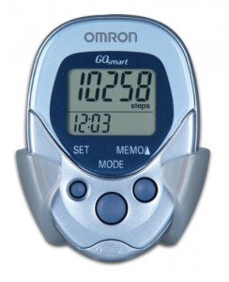
What are the best pedometers?
Least expensive:
Garmin Vivofit
Toobur Fitness Tracker
Amazfit Equator
Omron Alvita Ultimate
Withings Activite Pop
Wesoo K1 fitness tracker
Withings Go

Slide 4
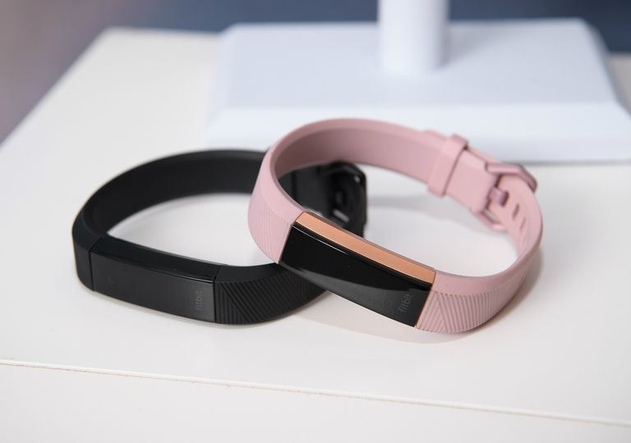
How do Pedometers work?
Modern pedometers work in a very similar way but are partly electronic.
The pedometer shows a count of your steps on a LCD display most will convert the step count to an approximate distance in miles or kilometers (or the number of calories you have burnt off).

Slide 5
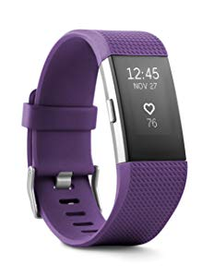
How do Pedometers work?
Pedometers can measure your steps because your body swings from side to side as you walk.
Inside is an accelerometer which moves and counts your steps or swing. Each swing counts as one step.
Multiplying the number of swings by the average length of your steps tells you how far you’ve gone.

Slide 6
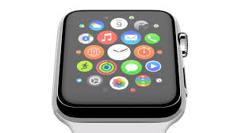
Apple Watch
Apple Watch is a line of smartwatches designed, developed, and marketed by Apple Inc.
It incorporates fitness tracking and health-oriented capabilities with integration with iOS and other Apple products and services.

Slide 7
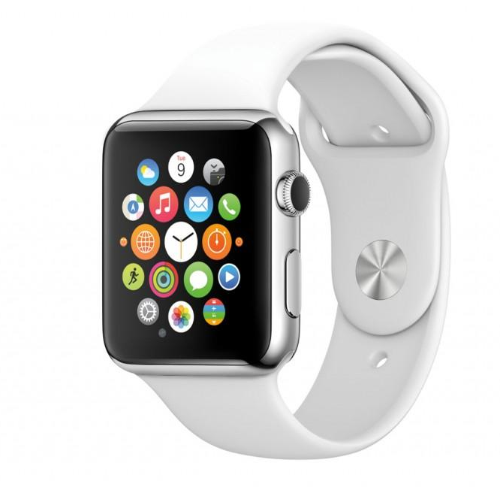
Apple Watch
Apple Watch relies on a wireless connection to an iPhone to perform many of its default functions such as calling and texting.
However, Wi-Fi chips in all Apple Watch models allow the smartwatch to have limited connectivity features away from the phone anywhere a Wi-Fi network is available.

Slide 8
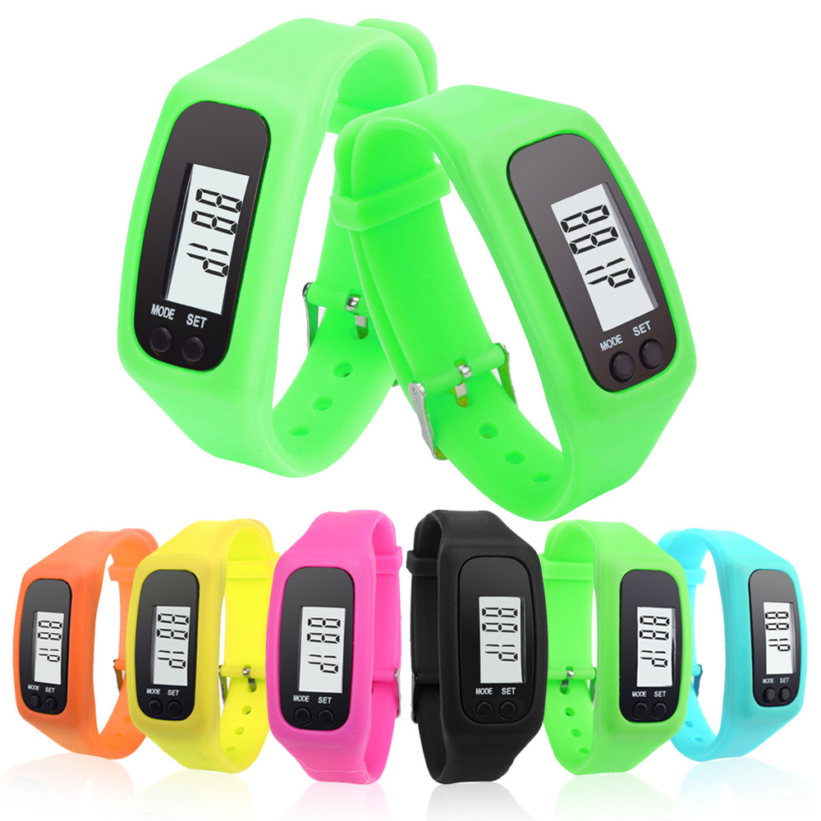
How can pedometers help?
By counting your steps it helps you to set yourself a goal each day
It inspires you to keep fit
Some even give you tips on what to eat
You could even do it with your whole family
It makes a good present

Slide 9
When were they first invented?
In 1780 Abraham-Louis Perrelet of Switzerland created the first pedometer, measuring the steps and distance while walking.
It was based on a 1770 mechanism to power a self-winding watch.
A mechanical pedometer obtained from France was introduced in the US by Thomas Jefferson.

Slide 10
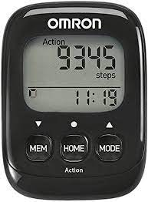
Facts about different pedometers...
Omron Walking Style IV Step Counter: Best pedometer under £25
Aerobic Steps - displayed separately from daily walking routine
Action Mode - records specific activity throughout the day
Burned calories and 10000 steps achievement indicator
Battery saving mode - turns display off after 5 minutes Auto Stride, Automatic reset to 0 every 24h, Units switch (lb-kg, feet/inch-cm, mile-km

Slide 11
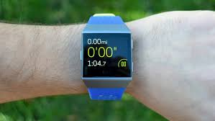
Facts about different makes of pedometers:
Fitbit Charge 3:
Understand your health and take action to improve with Fitbit Charge 3.
An advanced health and fitness tracker that uses 24/7 heart rate and personalised insights to reveal what's below the surface.

Slide 12
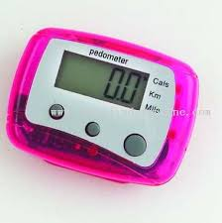
Pedometer Fun Facts
To count walking steps without a pedometer you need to track how long it takes you to walk 1 mile(4 laps around a track).
1 mile equals about 2000 steps.
Once calibrated to your stride length, the small device is quite accurate in measuring your walking distance daily.

Slide 13
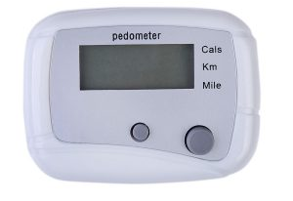
Pedometer Fun Facts
Using a pedometer to measure your steps can motivate you to move more.
Pedometers may give you a rough estimate of how far you've run, but will not be 100 percent accurate because your stride changes.
A pedometer is also called a step counter. Some pedometers also tell you how many calories you've burned. But calorie readings are estimates and may not be accurate.

